Slide 1
Assessing The Factual Accuracy of Generated Text
ADVISOR: JIA-LING, KOH
SOURCE: KDD ’19
SPEAKER: kuan-yu, sheng
DATE: 2020/08/13

Slide 2
Outline
Introduction
Method
Experiment
Conclusion

Slide 3
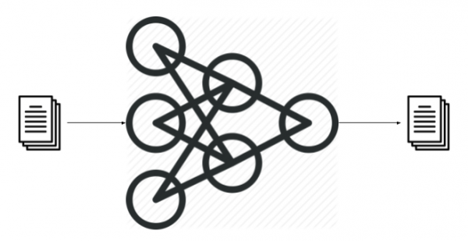
Introduction
3
Accurate or not ?
Test Generation tasks
Text summarization
Machine translation
Dialogue response generation
….

Slide 4
Introduction
4
General evaluation metrics :
ROUGE (recall base)
Ground Truth : the cat is in the box.
Generate: the cat is hiding in the bush.
1-gram
2-gram
the | Cat | is | in | the | box
the | Cat | is | hiding | in | the | bush
5/7
The cat | Cat is | Is in | In the | The box
The cat | Cat is | Is hiding | Hiding in | In the | The bush
3/6

Slide 5
Introduction
5
Ground Truth : The cat is in the box.
Generate sentence: The cat is hiding in the bush.
Rouge-1 = 5/7
Rouge-2 = 3/6
?
?
?
Make sense?
different
Ground Truth Relation tuple ( cat , in , box )
Generate sentence Relation tuple ( cat , hide in , bush )
Make more sense!!

Slide 6
Outline
Introduction
Method
Experiment
Conclusion

Slide 7
Method
Define fact tuple
fact f define : relation tuple (subject, relation, object)
Barack Hussein Obama II (born August 4, 1961) is an American politician who served as the 44th President of the United States from January 20, 2009 to January 20, 2017.
(Barack Obama, president of, United States)
(Barack Obama, born on, August 4 1961)

Slide 8
Method
Define fact acc sore

Slide 9
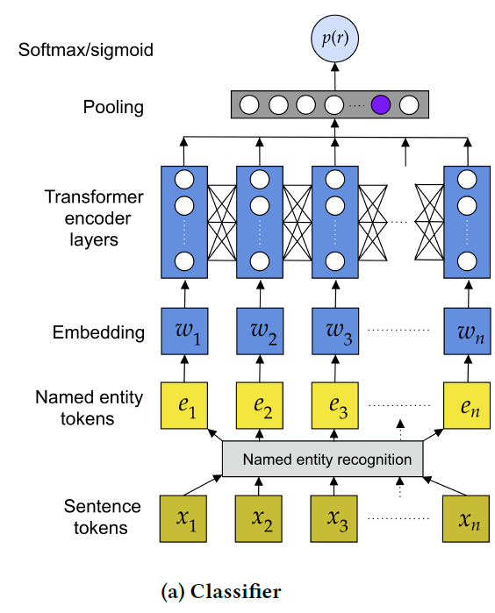
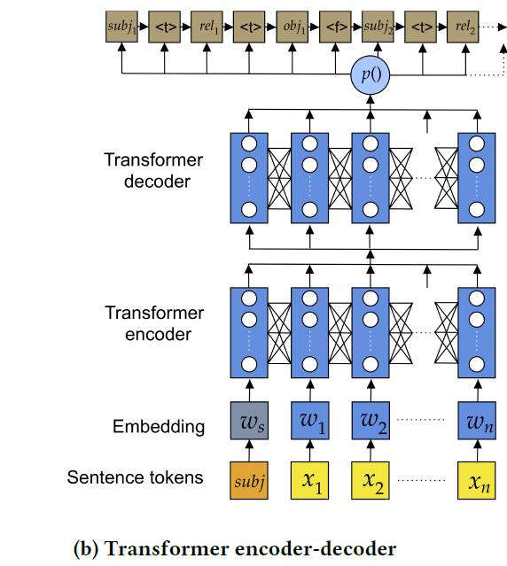
Method
Model overview

Slide 10
Method
Transformer encoder-decoder
X → Entire text
$e_{s }$→ subject entity
[ $e_{s }$; X ]
“ Person1 was born in Country1. He was a painter”
Transformer
“Person1 ⟨t⟩ born in ⟨t⟩ Country1 ⟨f⟩ Person1 ⟨t⟩ profession ⟨t⟩ painter ⟨end⟩”
⟨t ⟩ separates tokens within the fact f.
⟨f ⟩ separates facts.
continue decoding until ⟨end ⟩.

Slide 11
Method
Transformer – Self Attention
$b^{1}$, $b^{2}$, $b^{3}$, $b^{4}$ can be parallelly computed !!!
$$b^{1}$$
$$b^{2}$$
$$b^{3}$$
$$b^{4}$$
$$b^{1}$$
$$b^{2}$$
$$b^{3}$$
$$b^{4}$$
Self-Attention Layer
$$a^{1}$$
$$a^{2}$$
$$a^{3}$$
$$a^{4}$$
$$a^{1}$$
$$a^{2}$$
$$a^{3}$$
$$a^{4}$$
以下投影片節錄自李弘毅老師的Transformer講解，若要看更完整的解說可自:https://www.youtube.com/watch?v=ugWDIIOHtPA&t=2615s

Slide 12
Method
Transformer – Self Attention
$$q^{i}=W^{q}a^{i}$$
$q$: query (to match others)
$k$: key (to be matched)
$$k^{i}=W^{k}a^{i}$$
$v$: information to be extracted
$$v^{i}=W^{v}a^{i}$$
$$q^{1}$$
$$k^{1}$$
$$v^{1}$$
$$q^{2}$$
$$k^{2}$$
$$v^{2}$$
$$q^{3}$$
$$k^{3}$$
$$v^{3}$$
$$q^{4}$$
$$k^{4}$$
$$v^{4}$$
$$a^{1}$$
$$a^{2}$$
$$a^{3}$$
$$a^{4}$$
$$a^{i}=Wx^{i}$$
$$x^{1}$$
$$x^{2}$$
$$x^{3}$$
$$x^{4}$$
以下投影片節錄自李弘毅老師的Transformer講解，若要看更完整的解說可自:https://www.youtube.com/watch?v=ugWDIIOHtPA&t=2615s

Slide 13
Method
Transformer – Self Attention
dot product
Scaled Dot-Product Attention:
$$α_{1,i}=q^{1}∙k^{i}/\sqrt{d}$$
d is the dim of $q$ and $k$
$$α_{1,1}$$
$$α_{1,2}$$
$$α_{1,3}$$
$$α_{1,4}$$
$$q^{1}$$
$$k^{1}$$
$$v^{1}$$
$$q^{2}$$
$$k^{2}$$
$$v^{2}$$
$$q^{3}$$
$$k^{3}$$
$$v^{3}$$
$$q^{4}$$
$$k^{4}$$
$$v^{4}$$
$$a^{1}$$
$$a^{2}$$
$$a^{3}$$
$$a^{4}$$
$$x^{1}$$
$$x^{2}$$
$$x^{3}$$
$$x^{4}$$
以下投影片節錄自李弘毅老師的Transformer講解，若要看更完整的解說可自:https://www.youtube.com/watch?v=ugWDIIOHtPA&t=2615s

Slide 14
Method
Transformer – Self Attention
$${\hat{α}}_{1,i}=exp\left(α_{1,i} \right)/\sum_{j}{exp\left(α_{1,j} \right)}$$
$${\hat{α}}_{1,1}$$
$${\hat{α}}_{1,2}$$
$${\hat{α}}_{1,3}$$
$${\hat{α}}_{1,4}$$
Soft-max
$$α_{1,1}$$
$$α_{1,2}$$
$$α_{1,3}$$
$$α_{1,4}$$
$$q^{1}$$
$$k^{1}$$
$$v^{1}$$
$$q^{2}$$
$$k^{2}$$
$$v^{2}$$
$$q^{3}$$
$$k^{3}$$
$$v^{3}$$
$$q^{4}$$
$$k^{4}$$
$$v^{4}$$
$$a^{1}$$
$$a^{2}$$
$$a^{3}$$
$$a^{4}$$
$$x^{1}$$
$$x^{2}$$
$$x^{3}$$
$$x^{4}$$
以下投影片節錄自李弘毅老師的Transformer講解，若要看更完整的解說可自:https://www.youtube.com/watch?v=ugWDIIOHtPA&t=2615s

Slide 15
Method
Transformer – Self Attention
Considering the whole sequence
$$b^{1}=\sum_{i}{{\hat{α}}_{1,i} ∗ v^{i} }$$
$$b^{1}$$
$${\hat{α}}_{1,1}$$
$${\hat{α}}_{1,2}$$
$${\hat{α}}_{1,3}$$
$${\hat{α}}_{1,4}$$
$$q^{1}$$
$$k^{1}$$
$$v^{1}$$
$$q^{2}$$
$$k^{2}$$
$$v^{2}$$
$$q^{3}$$
$$k^{3}$$
$$v^{3}$$
$$q^{4}$$
$$k^{4}$$
$$v^{4}$$
$$a^{1}$$
$$a^{2}$$
$$a^{3}$$
$$a^{4}$$
$$x^{1}$$
$$x^{2}$$
$$x^{3}$$
$$x^{4}$$
以下投影片節錄自李弘毅老師的Transformer講解，若要看更完整的解說可自:https://www.youtube.com/watch?v=ugWDIIOHtPA&t=2615s

Slide 16
Method
Transformer – Self Attention
$$b^{2}$$
$$b^{2}=\sum_{i}{{\hat{α}}_{2,i}v^{i} }$$
$${\hat{α}}_{2,1}$$
$${\hat{α}}_{2,2}$$
$${\hat{α}}_{2,3}$$
$${\hat{α}}_{2,4}$$
$$q^{1}$$
$$k^{1}$$
$$v^{1}$$
$$q^{2}$$
$$k^{2}$$
$$v^{2}$$
$$q^{3}$$
$$k^{3}$$
$$v^{3}$$
$$q^{4}$$
$$k^{4}$$
$$v^{4}$$
$$a^{1}$$
$$a^{2}$$
$$a^{3}$$
$$a^{4}$$
$$x^{1}$$
$$x^{2}$$
$$x^{3}$$
$$x^{4}$$
以下投影片節錄自李弘毅老師的Transformer講解，若要看更完整的解說可自:https://www.youtube.com/watch?v=ugWDIIOHtPA&t=2615s

Slide 17
Method
Transformer – Self Attention
$b^{1}$, $b^{2}$, $b^{3}$, $b^{4}$ can be parallelly computed.
$$b^{1}$$
$$b^{2}$$
$$b^{3}$$
$$b^{4}$$
Self-Attention Layer
$$a^{1}$$
$$a^{2}$$
$$a^{3}$$
$$a^{4}$$
$$x^{1}$$
$$x^{2}$$
$$x^{3}$$
$$x^{4}$$
以下投影片節錄自李弘毅老師的Transformer講解，若要看更完整的解說可自:https://www.youtube.com/watch?v=ugWDIIOHtPA&t=2615s

Slide 18
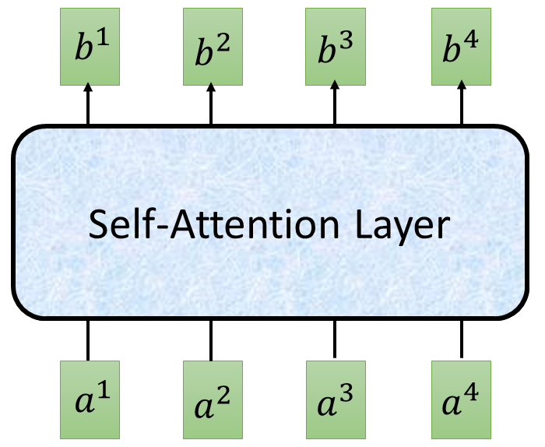
Method
Transformer – Self Attention
$$O$$
$$Q$$
=
$$I$$
$$W^{q}$$
$$K$$
=
$$I$$
$$W^{k}$$
$$V$$
=
$$W^{v}$$
$$I$$
$$I$$
$$\hat{A}$$
$$A$$
=
$$Q$$
$$K^{T}$$
$$\hat{A}$$
$$O$$
=
$$V$$
以下投影片節錄自李弘毅老師的Transformer講解，若要看更完整的解說可自:https://www.youtube.com/watch?v=ugWDIIOHtPA&t=2615s

Slide 19
Method
Multi-head Self Attention (2 heads as example)
$$b^{i,1}$$
$$q^{i,1}=W^{q,1}q^{i}$$
$$q^{i,2}=W^{q,2}q^{i}$$
$$q^{i,1}$$
$$q^{i,2}$$
$$k^{i,1}$$
$$k^{i,2}$$
$$v^{i,1}$$
$$v^{i,2}$$
$$q^{j,1}$$
$$q^{j,2}$$
$$k^{j,1}$$
$$k^{j,2}$$
$$v^{j,1}$$
$$v^{j,2}$$
$$q^{i}$$
$$k^{i}$$
$$v^{i}$$
$$q^{j}$$
$$k^{j}$$
$$v^{j}$$
$$q^{i}=W^{q}a^{i}$$
$$a^{i}$$
$$a^{j}$$
以下投影片節錄自李弘毅老師的Transformer講解，若要看更完整的解說可自:https://www.youtube.com/watch?v=ugWDIIOHtPA&t=2615s

Slide 20
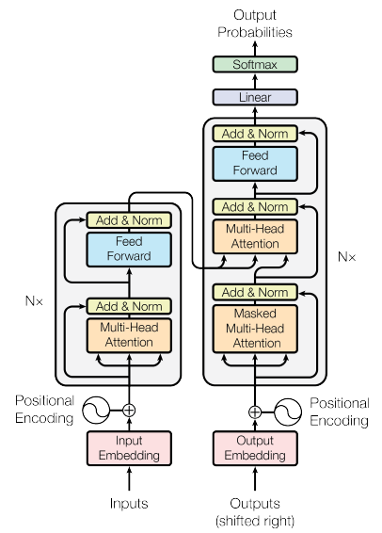
Method
Transformer
Encoder
Decoder
以下投影片節錄自李弘毅老師的Transformer講解，若要看更完整的解說可自:https://www.youtube.com/watch?v=ugWDIIOHtPA&t=2615s

Slide 21
Batch Size
Method
Transformer
Batch
$$μ=0,σ=1$$
Layer
Norm
$$b^{′}$$
+
Layer
$$μ=0,σ=1$$
$$b$$
attend on the input sequence
…
$$a$$
Masked: attend on the generated sequence
以下投影片節錄自李弘毅老師的Transformer講解，若要看更完整的解說可自:https://www.youtube.com/watch?v=ugWDIIOHtPA&t=2615s

Slide 22
Method
NER + Relation Classifier
After X do NER → Entity set {e}
For every pair (ei , ej ), ei != ej
All sentences Sl in X contain both entities(ei , ej ).
Add prefix tag before entity :
Prefix SUBJ for ei.
Prefix OBJ for ej.
Example:
X = Person1 was born in City1
Sl = SUBJ{ Person1 } was born in OBJ{ City1 }.
s1~sn

Slide 23
Method
NER + Relation Classifier
K relations
$$p_{\text{1} }$$
$$p_{\text{2} }$$
$$p_{\text{3} }$$
……
$$p_{\text{k} }$$
$$p_{\text{4} }$$
$$p_{\text{k}\text{−1} }$$
SUBJ{ Person1 } was born in OBJ{ City1 }.
Person1 was born in City1

Slide 24
Method
NER + Binary Relation Classifier
SUBJ{ Person1 } was born in OBJ{ City1 }.
Person1 was born in City1

Slide 25
Outline
Introduction
Method
Experiment
Conclusion

Slide 26
EXPERIMENT
26
Performance on dataset
Notes:
Wikipedia corpus
Wikidata knowledge base WKB

Slide 27
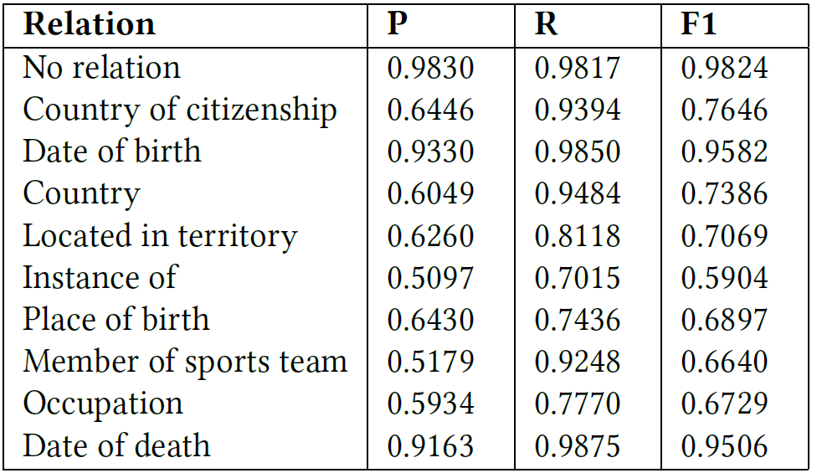
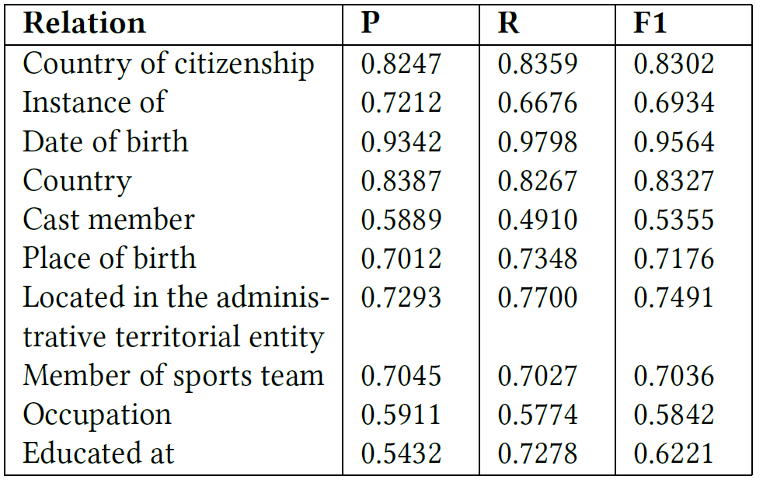
EXPERIMENT
27
Top 10 general relations

Slide 28
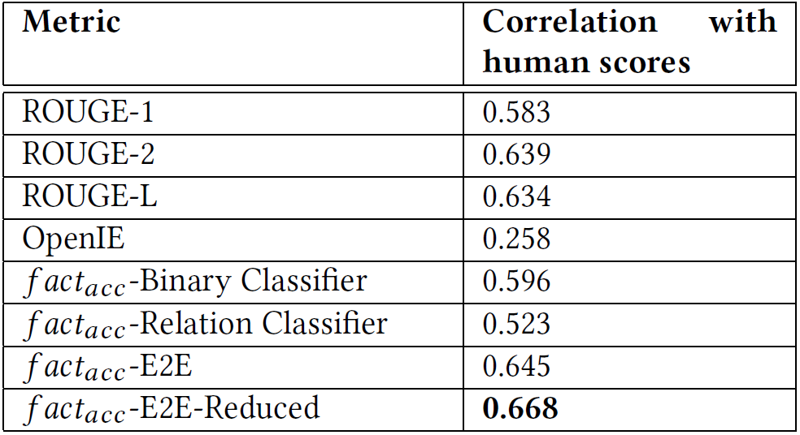
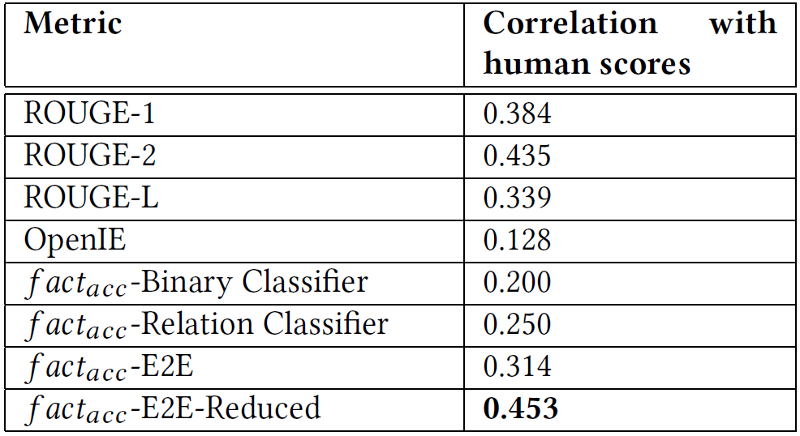
EXPERIMENT
28
Human Evaluation
Random sampling from summaries generated for Actors.
Random sampling from all categories in Wikipedia.

Slide 29
EXPERIMENT
29
Example
…...

Slide 30
Outline
Introduction
Method
Experiment
Conclusion

Slide 31
Conclusion
Limitation:
Our models are biased to sentences structured to the neutral tone set in Wikipedia
Discussion:
Our proposed metric is able to indicate the factual accuracy of generated text, and agrees with human judgment.
Classifiers and end-to-end models with straightforward architectures are able to perform competitive fact extraction.

